Slide 1
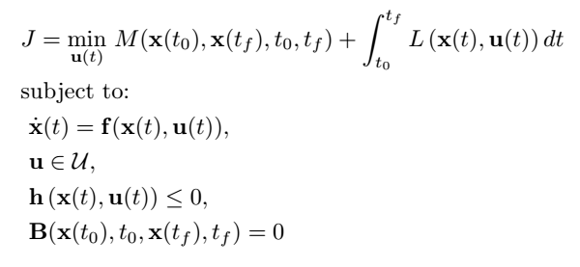
The jump between two points is computed via Optimal Control.
We use the indirect variational approach according to Pontryagin Maximum Principle.
The Bolza problem that we solve is the following:

Slide 2


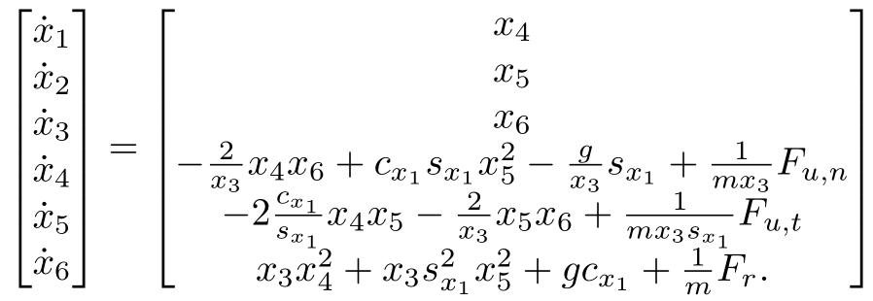
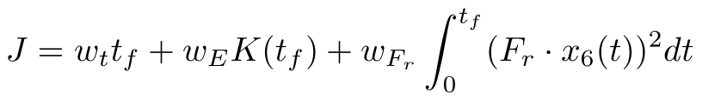
Specifically, we consider 6 state variables:
2 control inputs:
The dyamic system of the model is:
The optimisation target function is:

Slide 3

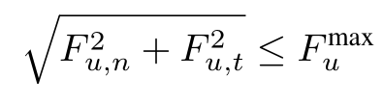




The constraints of the problem are:
Bounded retraction force:
Limited jump actuation force:
Friction constraint:
Motion outside the wall:
Generic obstacle:
For a conical obstacle:

